Slide 1


JAVA INTERVIEW BOOTCAMP
Lecture 7

Slide 2

Today’s Agenda
Packages
Import Statement
Static Import
Tricky Interview Questions
Java Class Structure
Naming Conventions

Slide 3
What Is A Package ?
Package is an organized collection of related types.
Related types means classes , interfaces and enums
Packaging is encouraged by Java coding standards to decrease the likelihood of classes colliding.

Slide 4
Key Benefits Of Packages
Code reuse
Maintainability
Object-oriented principle of encapsulation and modularity.

Slide 5
Drawbacks Without Packages
A class without a package cannot be imported elsewhere.
Accidental overwriting of bytecode

Slide 6
Creating A Package
To place a source file into a package, we use the package keyword at the beginning of that file.
package kapoor.sachin;
We may use zero or one package statements per source file.
To import classes from other packages into our source file, use the import statement.
The java.lang package that houses the core language classes is imported by default.

Slide 7
Example
package in.scabhopal.example;
import java.util.Scanner;
class Demo
{
public static void main(String [ ] args)
{
Scanner kb=new Scanner(System.in);
System.out.println(“Enter name:”);
String name=kb.nextLine();
System.out.println(“Hello “+name);
}
}

Slide 8
How To Compile The Code ?
To compile the previous code we would write the javac command using –d switch as follows:
javac –d . Demo.java
The above command indicates three things:
-d tells the compiler that complete package structure i.e. in.scabhopal.example has to be created if it doesn’t exists
. i.e. period tells the compiler that the package has to be created at current location
The name Demo.java is the name of the source code to be compiled
So after compilation the complete package structure will be created and the .class file called Demo.class will be placed inside the package in.scabhopal.example

Slide 9
How To Run The Code ?
To run the code we will write the java command mentioning the compete package structure followed by the class name , as follows
java in.scabhopal.example.Demo

Slide 10
The Default Package
Whenever we write a Java code without the package keyword , it goes to the default package.
So if a programs omits the package name then Java creates something which it calls the default package.
Oracle strongly recommends that we do not use the default package.

Slide 11
Other Points About Packages
They are optional.
They are limited to one per source file.
Standard coding convention for package statements reverses the domain name of the organization or group creating the package.
For example, the package in.scabhopal.example.
Package name should be in lowercase letters
For example, the package kapoor.sachin

Slide 12

Interview Tip
Common packages we will be asked in the interview are packages for
The Java Basic Input/Output API
The Java Networking API
The Java Utilities API, and
The core Java Language API.
You will need to know the basic functionality that each
package/API contains..

Slide 13
The import Statement
Makes it possible to abbreviate references to data and methods in other packages.
Can be used in 3 ways:
Implicit: java.util.*;
Explicit: java.util.Scanner;
Another way is to use fully qualified naming :
java.util.Scanner kb=new java.util.Scanner(System.in)

Slide 14
The Static Import
Static import in Java allows to import static members of class and use them, as if they are declared in the same class.
Static import was introduced in Java 5.
General syntax:
import static <package_name>.<class_name>.<name of static member>;
Example:
import static java.lang.Math.PI;

Slide 15
The Import Statement
package test;
import static java.lang.Integer.MAX_VALUE;
import static java.lang.Integer.MIN_VALUE;
public class StaticImportExample {
public static void main(String args[]) {
System.out.println("Maximum value of int variable in Java without " +
"static import : " + Integer.MAX_VALUE);
System.out.println("Minimum value of int variable in Java without " +
static import : " + Integer.MIN_VALUE);
System.out.println("Maximum value of int variable using " +
static import : " + MAX_VALUE);
System.out.println("Minimum value of int variable using" +
static import : " + MIN_VALUE);
}
}

Slide 16
The Output
The Output:
Maximum value of int variable in Java without static import : 2147483647
Minimum value of int variable in Java without static import : -2147483648
Maximum value of int variable using static import : 2147483647
Minimum value of int variable using static import : -2147483648

Slide 17
Popular Interview Question
Correct Answer:
C
1. Given:
import static java.lang.Long.MAX_VALUE;
import static java.lang.Integer.MAX_VALUE;
public class StaticImp {
public static void main(String[] args) {
System.out.print(MAX_VALUE);
}
}
What is the result?
A. 9223372036854775807
B. 2147483647
C. Error
D. Exception

Slide 18
Popular Interview Question
Correct Answer:
B
2. Given:
import java.lang.Long.*;
import static java.lang.Integer.MAX_VALUE;
public class StaticImp {
public static void main(String[] args) {
System.out.print(MAX_VALUE);
}
}
What is the result?
A. 9223372036854775807
B. 2147483647
C. Error
D. Exception

Slide 19
Popular Interview Question
Correct Answer:
C
3. Given:
import java.lang.Long.*;
import static java.lang.Integer.MAX_VALUE;
public class StaticImp {
public static void main(String[] args) {
int MAX_VALUE=100;
System.out.print(MAX_VALUE);
}
}
What is the result?
A. 9223372036854775807
B. 2147483647
C. 100
D. Exception
E. Error

Slide 20
Popular Interview Question
Correct Answer:
E
4. Given:
import java.lang.Long.*;
import static java.lang.Integer.MAX_VALUE;
public class StaticImp {
int MAX_VALUE=100;
public static void main(String[] args) {
System.out.print(MAX_VALUE);
}
}
What is the result?
A. 9223372036854775807
B. 2147483647
C. 100
D. Exception
E. Error

Slide 21
Points To Remember
Static import statements are written as "import static" in code and not "static import".
If we import two static fields with same name explicitly e.g. Integer.MAX_VALUE and Long.MAX_VALUE then Java will throw compile time error.
But if other static modifier is not imported explicitly for ex. we have imported java.lang.Long.*, MAX_VALUE will refer to Integer.MAX_VALUE.
We can apply static import statement not only on static fields but also on static methods in Java.

Slide 22
Some Important Packages
1. To paint basic graphic and images, which package should we use ?
java.awt
2.To create lightweight components for GUI which package should we use ?
java.swing
3.To utilize data streams which package should we use ?
java.io

Slide 23
Some Important Packages
4. To develop a networking application which package should we use ?
java.net
5.To work with collections framework and date-time facilities which package should we use ?
java.util
6.To work with core classes which package should we use ?
java.lang
7.To work with advance classes which package should we use ?
none , inavlid question!

Slide 24
Understanding Package Classes
Oracle includes 224 packages in the Java SE 14 API containing 4569 classes
Each package has a specific focus.
Fortunately, we need to be familiar with only a few of them for the Interview . They are:
Java Utility API
Java Basic Input/Output API
Java Networking API
The Core Java Language API.

Slide 25
The java.util Package
The Java Utilities API is contained in the package java.util.
This API provides functionality for a variety of utility classes.
The API’s key classes and interfaces can be divided into several categories.

Slide 26
The java.util Package
Categories of classes that may be seen on the interview include the Java Collections Framework, date and time facilities and some miscellaneous utility classes.
Of these categories, the Java Collections Framework pulls the most weight since it is frequently used and provides the fundamental data structures necessary to build valuable Java applications.

Slide 27
Useful Types Of Collections
Interface | Implementation | Purpose
List | ArrayList,LinkedList, Vector | Allows positional access
Set | HashSet,TreeSet | Allows to maintain uniquenes
Map | HashMap,TreeMap, Hashtable | Maps keys to value

Slide 28
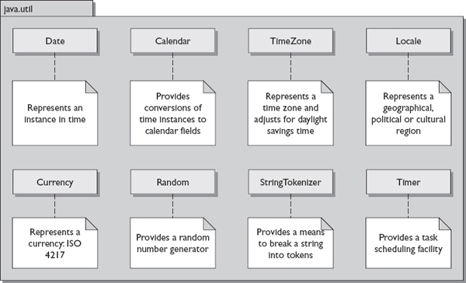
Useful Utility Classes

Slide 29
Example Of Calendar Class
import java.util.*;
public class Calendar1 {
public static void main(String args[])
{
Calendar c = Calendar.getInstance();
System.out.println("The Current Date is:" +c.getTime());
}
}
OUTPUT:

Slide 30
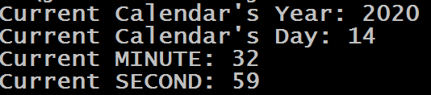
Example Of Calendar Class
import java.util.*;
public class CalenDarDemo2 {
public static void main(String[] args)
{
Calendar calendar = Calendar.getInstance();
System.out.println("Current Calendar's Year: " + calendar.get(Calendar.YEAR));
System.out.println("Current Calendar's Day: " + calendar.get(Calendar.DATE));
System.out.println("Current MINUTE: " + calendar.get(Calendar.MINUTE));
System.out.println("Current SECOND: " + calendar.get(Calendar.SECOND));
}
}
OUTPUT:

Slide 31
Example Of TimeZone Class
import java.util.*;
public class TimeZoneExample1 {
public static void main( String args[] ){
String[] id = TimeZone.getAvailableIDs();
System.out.println("In TimeZone class available Ids are: ");
for (int i=0; i<id.length; i++){
System.out.println(id[i]);
}
}
}

Slide 32
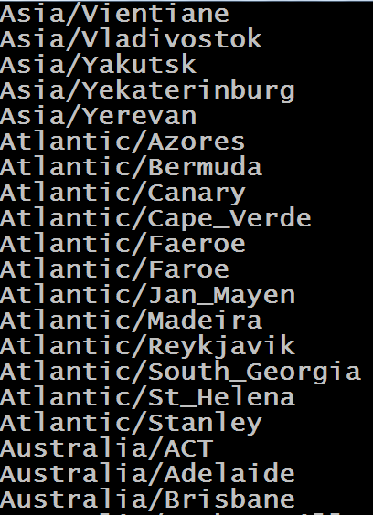
Example Of TimeZone Class
OUTPUT:

Slide 33

Example Of TimeZone Class
import java.util.*;
public class TimeZoneExample2 {
public static void main( String args[] ){
Calendar calendar = Calendar.getInstance();
System.out.println("Current hour in India = " + calendar.get(Calendar.HOUR_OF_DAY));
TimeZone timeZone1 = TimeZone.getTimeZone("America/New_York");
calendar.setTimeZone(timeZone1);
System.out.println("Current hour in NewYork = " + calendar.get(Calendar.HOUR_OF_DAY));
}
}
OUTPUT:

Slide 34
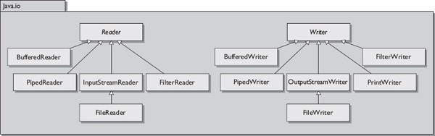
Useful I/O Classes

Slide 35
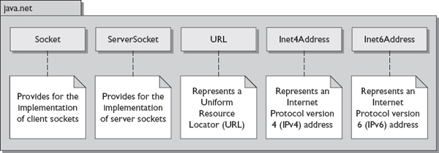
Useful Networking Classes

Slide 36
Popular Interview Question
Which import statement will allow for the import of the HashMap class?
A. import java.util.HashMap;
B. import Java.util.*;
C. import java.util.HashMap.*;
D. import java.util.hashMap;
Correct Answer: A
2 . Which statement would designate that your file belongs in the package
in.scabhopal.utilities?
A. pack in.scabhopal.utilities;
B. package In.scabhopal.utilities.*
C. package in.scabhopal.utilities.*;
D. package in.scabhopal.utilities;
Correct Answer: D

Slide 37
Popular Interview Question
3. Which of the following is the only Java package that is imported by default?
A. java.awt
B. java.lang
C. java.util
D. java.io
Correct Answer: B
4. What Java-related features are new to J2SE 5.0?(Choose all that apply)
A. Static imports
B. package and import statements
C. Autoboxing and unboxing
D. The enhanced for loop
Correct Answer: A,C,D

Slide 38
Popular Interview Question
5. The Java Basic I/O API contains what types of classes and interfaces?
A. Internationalization
B. RMI and JDBC
C. Data streams, serialization, and file system
D. Collection API and data streams
Correct Answer: C
6. Which package contains the Java Collections Framework?
A. java.io
B. java.net
C. java.util
D. java.utils
Correct Answer: C

Slide 39
Popular Interview Question
7. Which of the following statements about the default package ARE true.
A. You cannot import a class from the default package.
B. A class in the default package can only be used by other classes in the default package.
C. A class in the default package can be imported into classes in non-default packages.
D. A class in the default package can import classes in non-default packages.
Correct Answer: A,B,D
8. Consider the following code snippet:
1.
2. public class Storage {
3. public static void main(String[] args) {
4. int i = MAX_VALUE;
5. }
6. }
What do you have to insert into line 1 so you can use the static field MAX_VALUE of the Integer class?
A. import static java.lang.Integer.MAX_VALUE;.
B. import static java.lang.Integer;
C. import java.lang.Integer.MAX_VALUE;
D. import java.lang.Integer;
Correct Answer: A

Slide 40
Popular Interview Question
9. Given
1. package test;
2. ...
3. public class MathUtil {
4. double twoPis = PI * 2;
5. }
To prevent line 4 from causing a compile error, which line must be inserted into line 2?
A. import static Math.PI;.
B. import static java.lang.Math;
C. import static java.lang.Math.PI;
D. import java.lang.Math.PI;
Correct Answer: C

Slide 41
Understanding Class Structure
The Interviewer might question you on your understanding of the structure and components of a Java class defined using the keyword class.
A class can define multiple components. All the Java components that you’ve heard of can be defined within a Java class.
The figure on next slide defines the components and structure of a Java class.

Slide 42
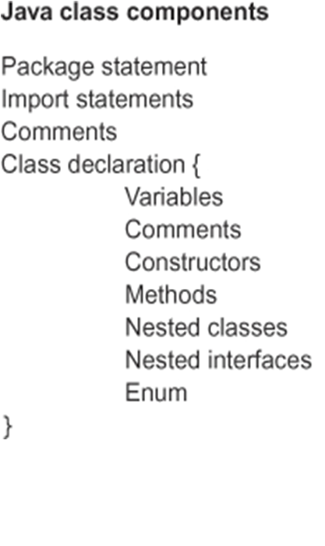
Understanding Class Structure

Slide 43
Other Properties Of A Java Class
Each class may extend one and only one super class.
Each class may implement one or more interfaces separated by commas.

Slide 44
Naming Conventions
Naming conventions are strict guidelines to be followed in creation of identifiers, methods, class names and so forth throughout our code base.
Coding to a set of code standards helps to reduce the effort involved in reading, maintaining, and enhancing any piece of code.

Slide 45
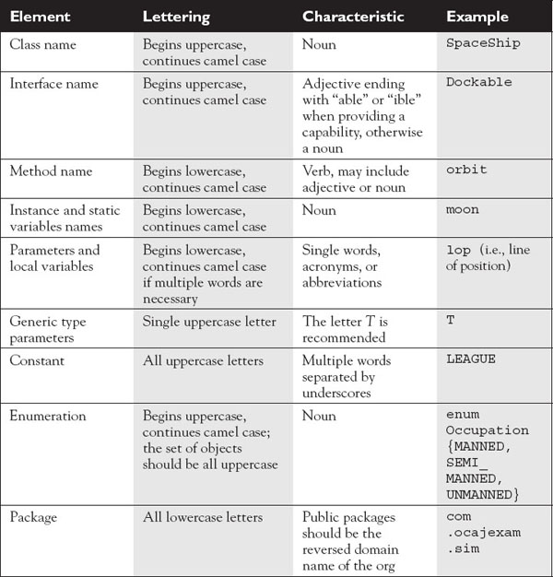
Naming Conventions

